Slide 1
CSE 460: VLSI Design
Lecture 6: Finite State Machines (part 2)

Slide 2
Synchronous Sequential Circuits Design
W
Combinational circuit
Combinational circuit
Z
Flip-flops
Q
Clock
Figure 8.1.
The general form of a sequential circuit.

Slide 3
Example 1: A simple input pattern detection circuit
We wish to design a circuit that meets the following specification
The circuit has one input W, and one output z.
All changes in the circuit occur on the positive edge of a clock signal.
The output z is equal to 1 if during two immediately preceding clock cycle the input w was equal to 1. Otherwise the value of z is equal to 0.
Clockcycle: | t₀ | t₁ | t₂ | t₃ | t₄ | t₅ | t₆ | t₇ | t₈ | t9 t10
w : | 0 | 1 | 0 | 1 | 1 | 0 | 1 | 1 | 1 | 0 1
z : | 0 | 0 | 0 | 0 | 0 | 1 | 0 | 0 | 1 | 1 0
Figure 8.2.
Sequences of input and output signals.

Slide 4
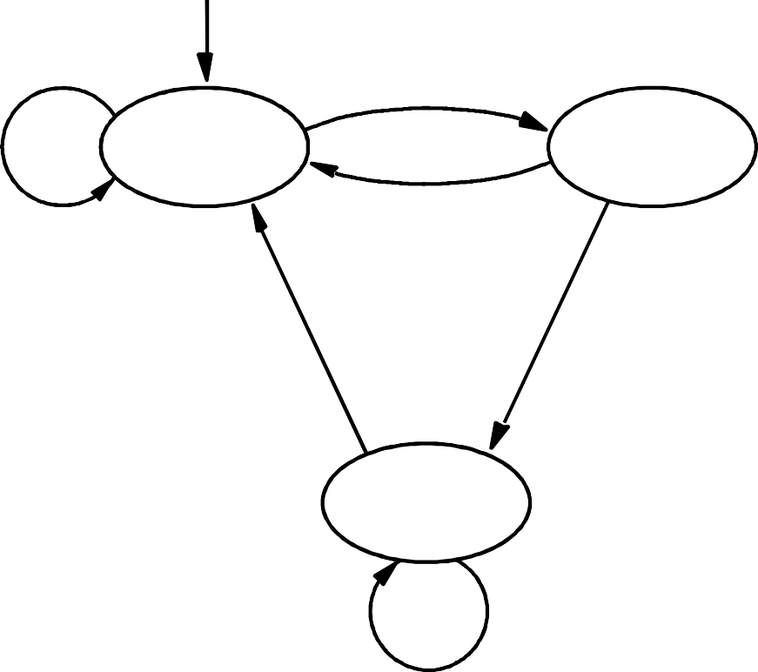
State Diagram
Reset
w = 1
w = 0
A ⁄ z = 0
B ⁄ z = 0
w = 0
w = 0
w = 1
C ⁄ z = 1
w = 1
Figure 8.3.
State diagram of a simple sequential circuit.

Slide 5
State Table
Present state | Next state |  |  |  |  |  | Output z
 | w | = | 0 | w | = | 1
A | A |  | B |  |  |  | 0
B | A |  | C |  |  |  | 0
C | A |  | C |  |  |  | 1
Figure 8.4. State table for the sequential circuit in Figure 8.3.

Slide 6
Present state
Next state
w = 0 w = 1
Output
z
 | y ₂ y ₁ | Y ₂ Y ₁ | Y ₂ Y ₁
A | 00 | 00 | 01 | 0
B | 01 | 00 | 10 | 0
C | 10 | 00 | 10 | 1
 | 11 | dd | dd | d
Note that the assignment of state C is different here from the video and so the circuit onwards will be a bit different
Figure 8.6.
State-assigned table for the sequential circuit in Figure 8.4.

Slide 7


w
Y₁
y₁
Combinational circuit
Combinational circuit
z
Y₂
y₂
Clock
Figure 8.5.
A general sequential circuit with input w, output z, and two state flip-flops.

Slide 8
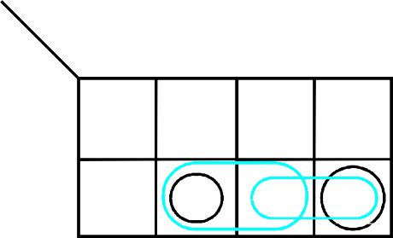
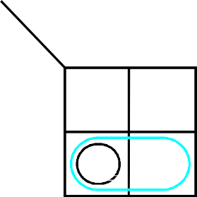
y y
2 1
w
00 01 11 10
Ignoring don't cares
Using don't cares
0
0
0
d
0
Y ₁ = wy ₁ y ₂
Y ₂ = wy ₁y ₂ + wy ₁y ₂
z = y ₁ y ₂
Y ₁ = wy ₁ y ₂
Y ₂ = wy ₁ + wy ₂
= w ( y ₁ + y ₂)
z = y ₂
1
1
0
d
0
y y
2 1
w
00 01 11 10
0
0
0
d
0
1
0
1
d
1
y ₁
y ₂
0
1
0
0
0
1
1
d
Figure 8.7.
Derivation of logic expressions for the sequential circuit in Figure 8.6.

Slide 9
Y₂
y₂
D Q
z
Q
Y₁
y₁
w
D
Q
Q
Clock Resetn
Figure 8.8.
Final implementation of the sequential circuit derived in Figure 8.7.

Slide 10
t₀ t₁ t₂ t₃ t₄ t₅ t₆ t₇ t₈ t₉
^{t}10
1
0
Clock
1
0
w
1
0
y₁
1
0
y
2
1
0
z
Figure 8.9.
Timing diagram for the circuit in Figure 8.8.

